Slide 1
Group 10
Final presentation.

Slide 2
Members/Contributors:
Areej Fatima, Chao Qun S, Julia G., Miguel F

Slide 3
Diabetes
Diabetes is a chronic (long-lasting) health condition that affects how your body turns food into energy. Your body breaks down most of the food you eat into sugar (glucose) and releases it into your bloodstream. When your blood sugar goes up, it signals your pancreas to release insulin.When its unable to that a person generally has diabetes.
The aim of today's presentation is to demonstrate a machine learning model that can predict diabetes.
We used a pre collected data from Diabetes, Hypertension and Stroke Prediction | Kaggle.
There are many Co-factors that contribute towards diabetes. We checked the correlation between them.
By correlation we mean to what extent does one have an effect on the other.
Notes:
Correlation is a statistical measure that expresses the extent to which two variables are linearly related (meaning they change together at a constant rate). It's a common tool for describing simple relationships without making a statement about cause and effect.

Slide 4
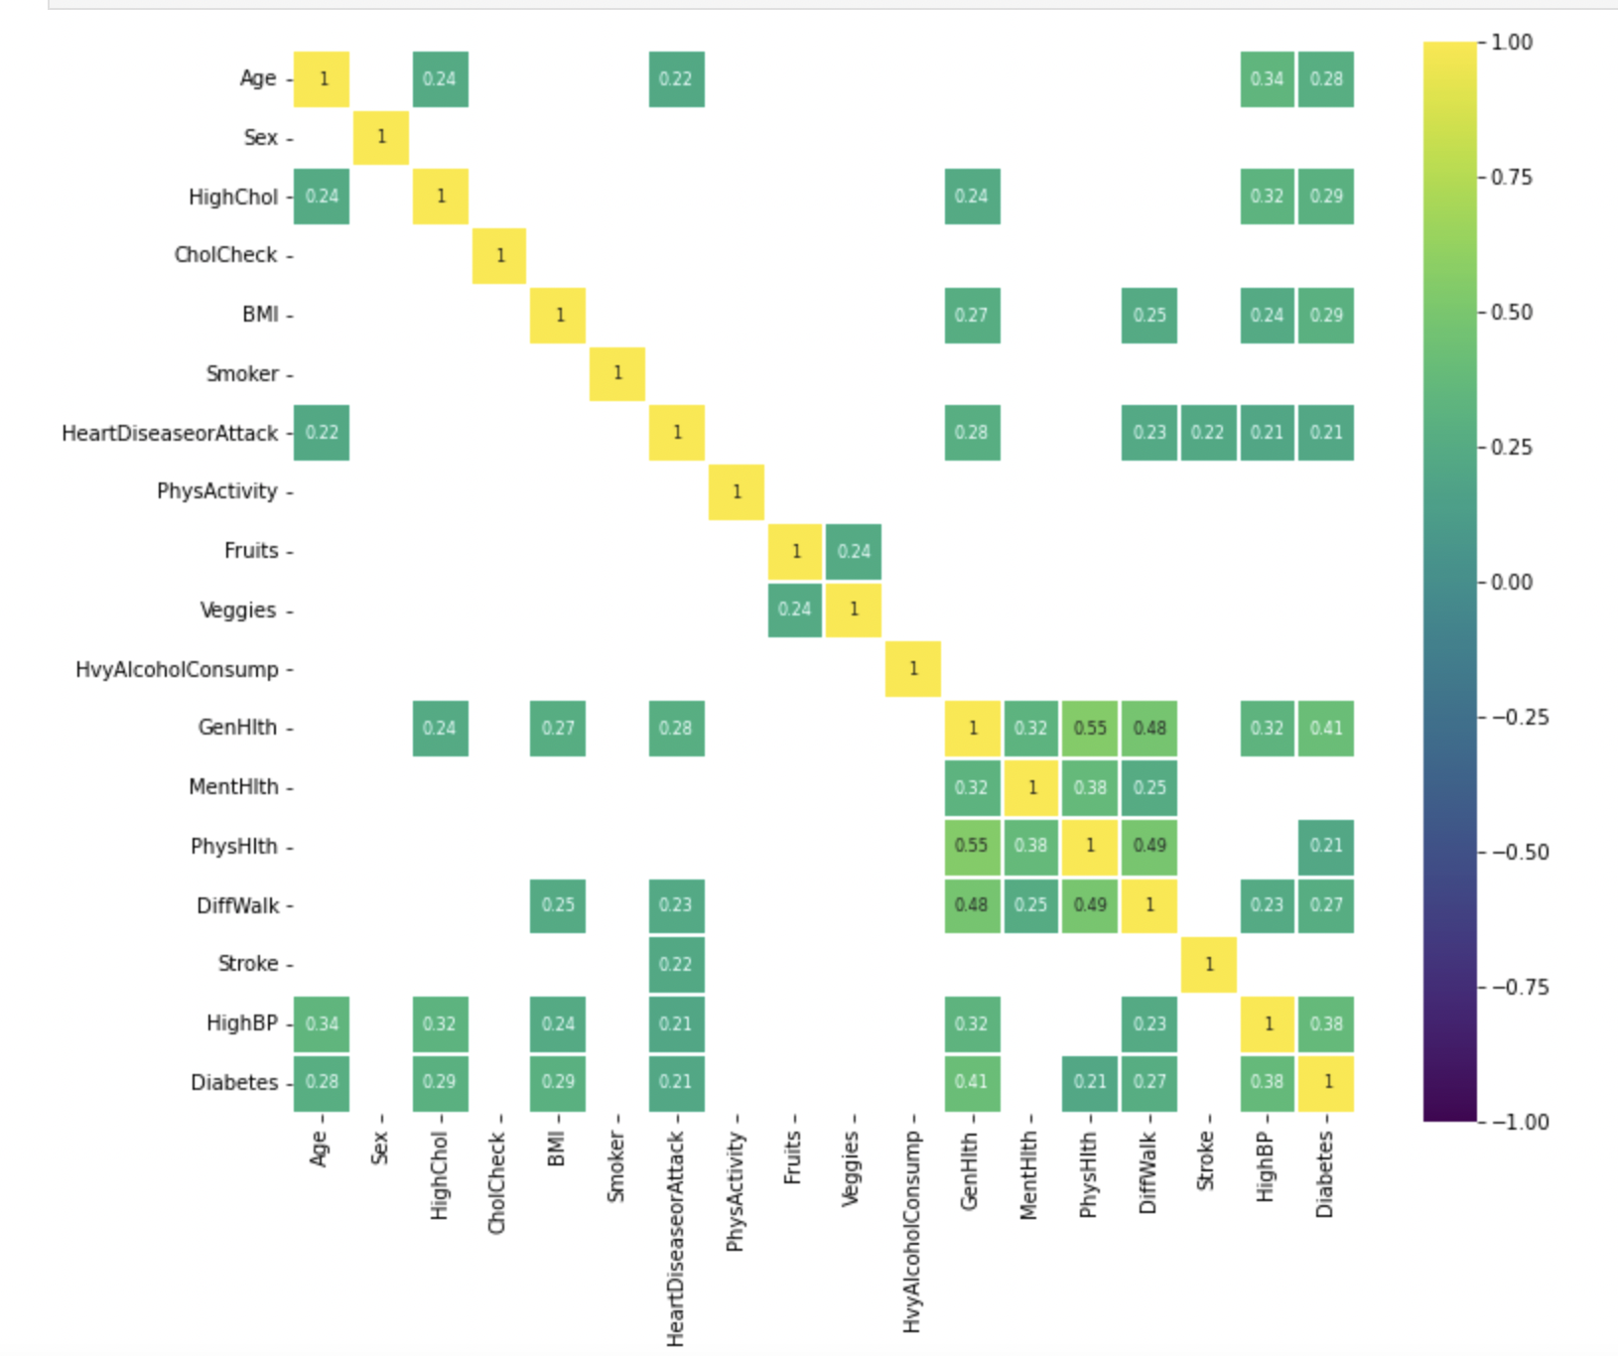
Correlation
The heatmap visualizes the correlation between two variables, thus allowing us to understand which variables are related and the strength of that relationship. We can see that General Health, High Blood Pressure, High Cholesterol and BMI have the highest correlation.

Slide 5
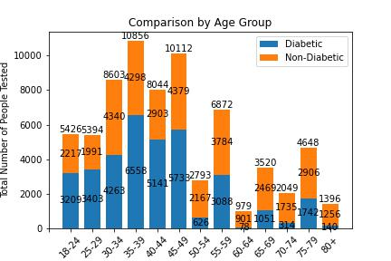

Slide 6
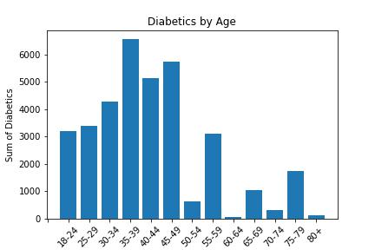
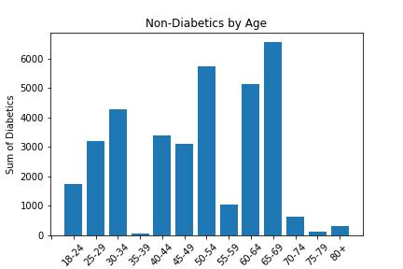

Slide 7
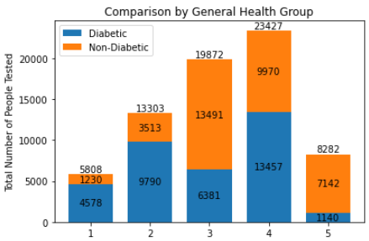
Notes:
1-21% non DB vs 79% DB+
5-86% non DB vs 14% DB +

Slide 8
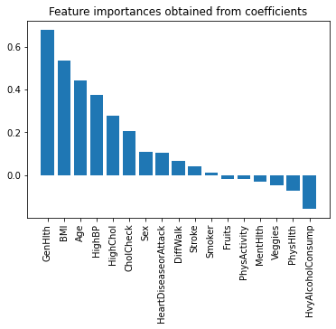
Notes:
Could be due to

Slide 9
What is a machine learning model?
A machine learning model is a file that has been trained to recognize certain types of patterns. You train a model over a set of data, providing it an algorithm that it can use to reason over and learn from that data.
Once you have trained the model, you can use it to reason over data that it hasn't seen before, and make predictions about those data. For example, let's say you want to build an application that can recognize a user's emotions based on their facial expressions. You can train a model by providing it with images of faces that are each tagged with a certain emotion, and then you can use that model in an application that can recognize any user's emotion.
In our case we used the diabetes data set to train the model to predict whether a person is diabetic or not.

Slide 10
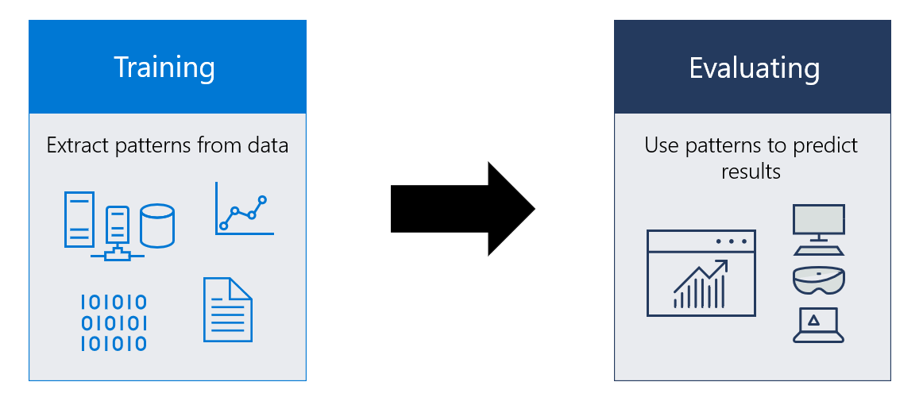

Slide 11
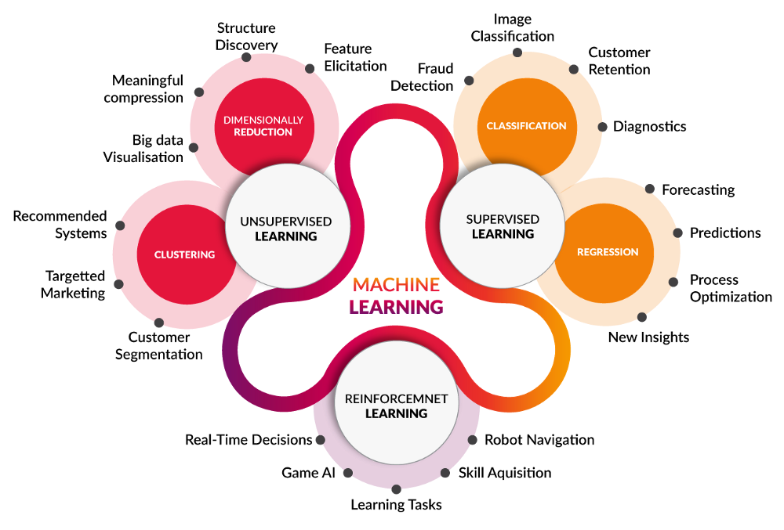

Slide 12
What are the most common and popular machine learning algorithms?
Naïve Bayes Classifier Algorithm (Supervised Learning - Classification)
K Means Clustering Algorithm (Unsupervised Learning - Clustering)
Support Vector Machine Algorithm (Supervised Learning - Classification)
Linear Regression (Supervised Learning/Regression)
Logistic Regression (Supervised learning – Classification)
Artificial Neural Networks (Reinforcement Learning)
Decision Trees (Supervised Learning – Classification/Regression)
Random Forests (Supervised Learning – Classification/Regression)
Nearest Neighbours (Supervised Learning)

Slide 13
Why not others?
The K-Nearest-Neighbour algorithm estimates how likely a data point is to be a member of one group or another. It essentially looks at the data points around a single data point to determine what group it is actually in.
Random forests or ‘random decision forests’ is an ensemble learning method, combining multiple algorithms to generate better results for classification, regression and other tasks.
A decision tree is a flow-chart-like tree structure that uses a branching method to illustrate every possible outcome of a decision. Each node within the tree represents a test on a specific variable – and each branch is the outcome of that test.
Logistic regression focuses on estimating the probability of an event occurring based on the previous data provided. It is used to cover a binary dependent variable, that is where only two values, 0 and 1, represent outcomes.
Linear regression is the most basic type of regression. Simple linear regression allows us to understand the relationships between two continuous variables.
Support Vector Machine algorithms are supervised learning models that analyse data used for classification and regression analysis.
The Naïve Bayes classifier is based on Bayes’ theorem and classifies every value as independent of any other value. It allows us to predict a class/category, based on a given set of features, using probability.

Slide 14
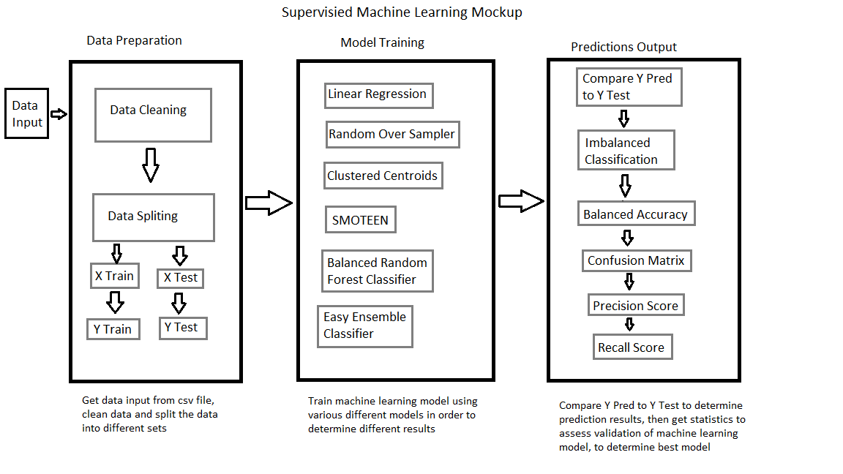

Slide 15
The best model
We chose SVM because of the confusion matrix, as majority of our models ranged at about the same accuracy; and even then SVM scored on the higher end with a 74.6% accuracy. We want the lowest amount of false negatives because we don’t want people who are actually diabetic given a statement saying that they’re not diabetic

Slide 16
How does it work?
A SVM is a type of classification model that uses
an explanatory variable, x
to predict a known response, y.
Supervised models are trained on a subset of the known data and the corresponding predictive accuracy is assessed using test data. This process is known as cross-validation.
Accuracy is defined as the percentage of correctly classified samples.

Slide 17
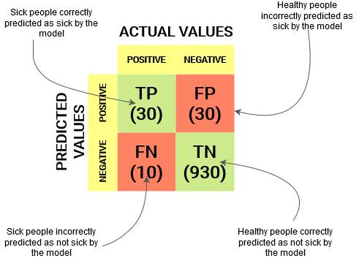
Confusion Matrix Explanation.

Slide 18
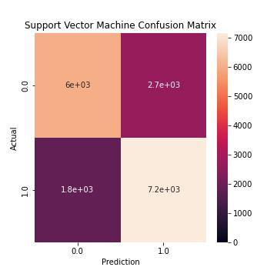
DB+ people correctly predicted
As DB+
DB- people incorrectly predicted as DB+
DB- people correctly predicted as DB-
DB+ people incorrectly predicted as DB-

Slide 19
Five questions we plan to answer:
Can our ML model predict diabetes? YES with an accuracy of 74.6%
Does age increase the diabetes risk? (Binning by age / Bar graph).YES
Is there a correlation between BMI and diabetes onset? YES
Is one gender more likely to develop diabetes? YES
Negative correlation - heavy consumers are less likely to develop diabetes?

Slide 20
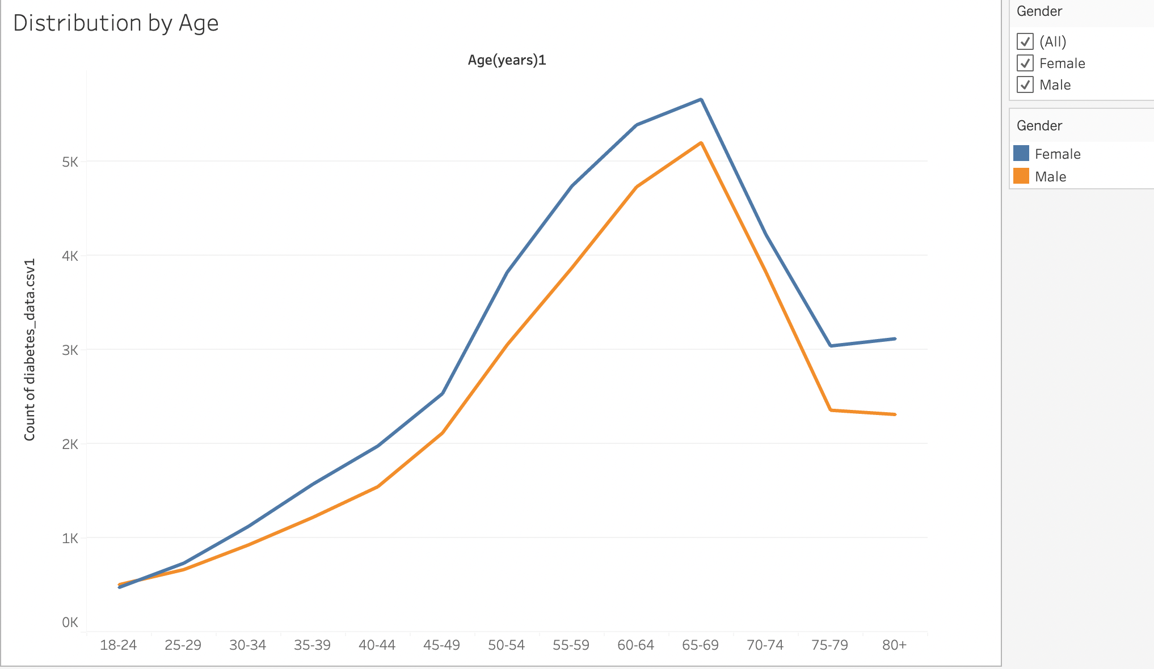
Does age increase the diabetes risk? (Binning by age / Bar graph).YES

Slide 21
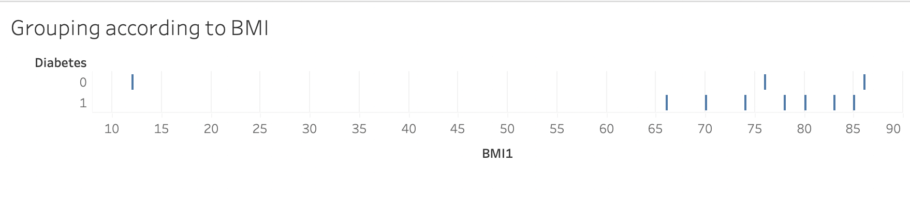
Is there a correlation between BMI and diabetes onset? YES

Slide 22
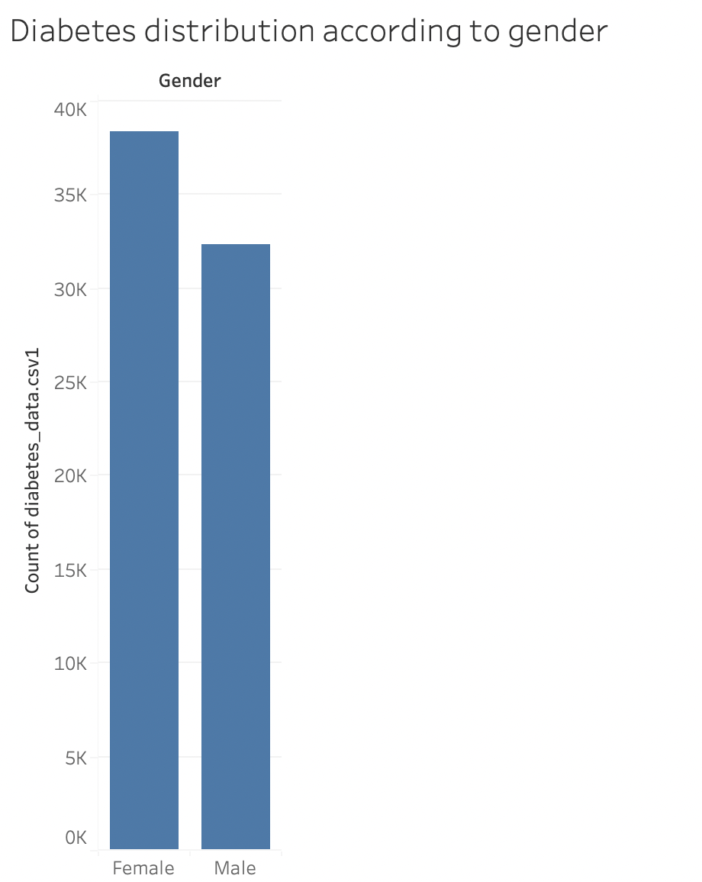
Is one gender more likely to develop diabetes? YES-Females

Slide 23
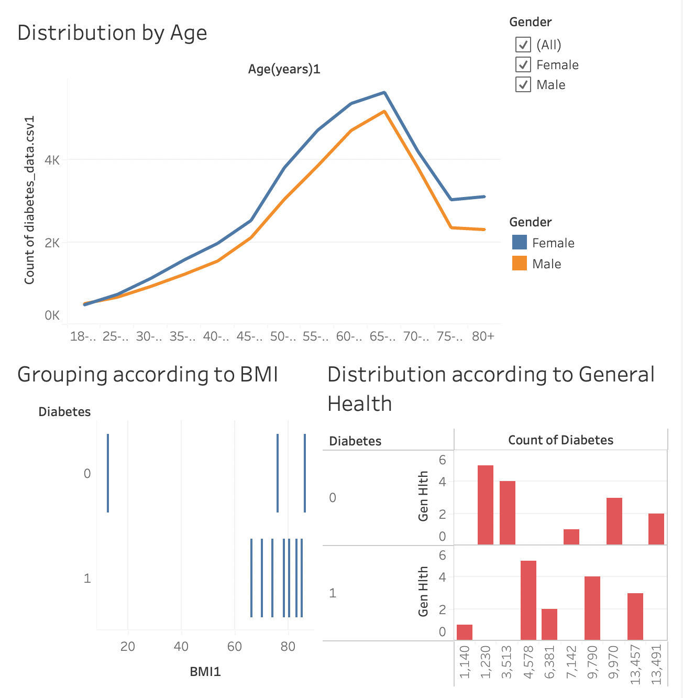
Dashboard

Slide 24
Conclusion
So in conclusion it is safe to say that not one factor can determine accurately if someone is prone to diabetes.
Also the data that we used has some missing field such as :Genetic predisposition,If it is type 1 or type 2
And so on…
Maybe this model can be used to filter out the general public who should regularly be tested for Diabetes fir early intervention.
Benefits of using SVM:
SVM works relatively well when there is a clear margin of separation between classes. SVM is more effective in high dimensional spaces and is relatively memory efficient.

